Slide 1

Customer Buying Prediction
Insights via dataset exploration and predictive models.
17th august 2024

Slide 2
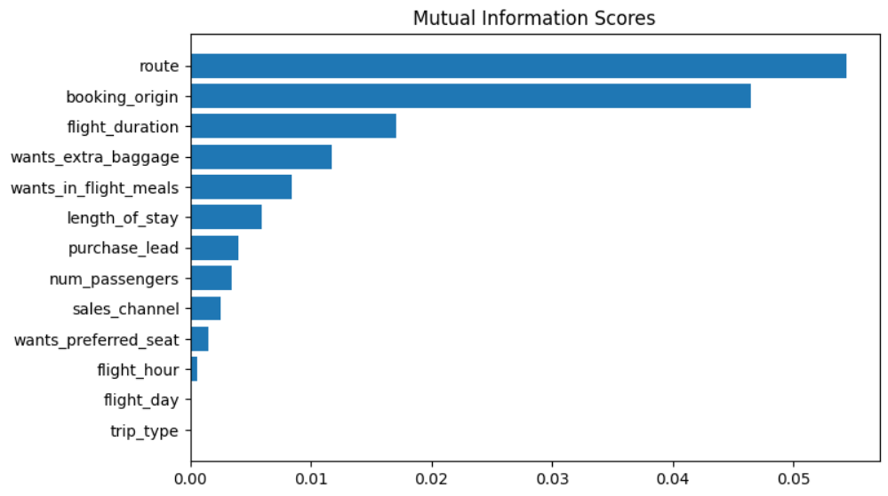
Top 5 variables influencing customer buying behavior
Route
Booking Origin
Flight Duration
Wants Extra Baggage
Want In Flight Meals
Mutual Information is a measure of the dependency between variables, often used in feature selection to understand how much information a feature contributes to predicting the target variable.
Trained the dataset provided with random forest classifier model
Accuracy – 82.94
AUC score – 0.743
We must aim to maximize the AUC score.

